Slide 1
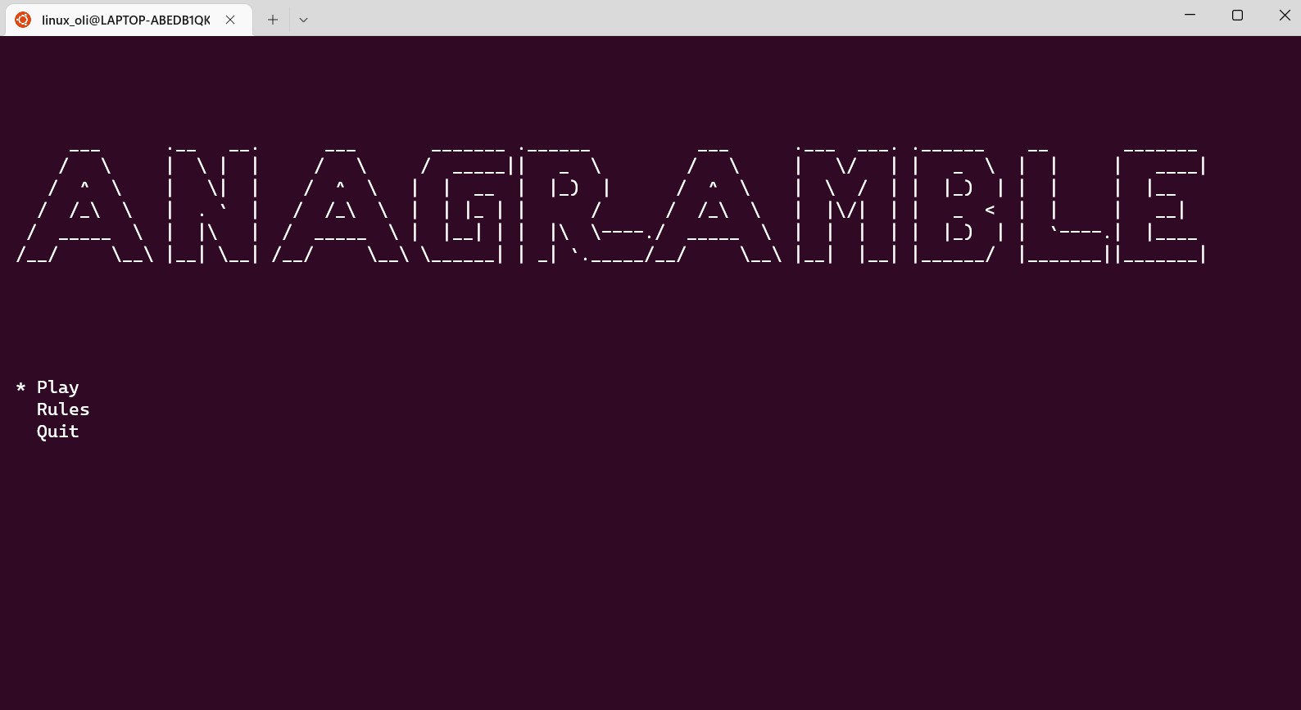
T1 A3 Slide Deck
Oliver Wong

Slide 2
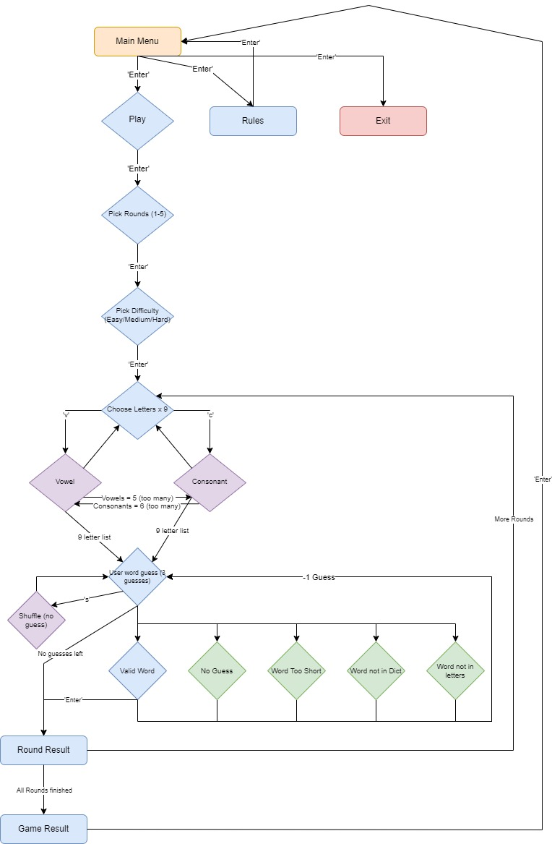
Flowchart!

Slide 3
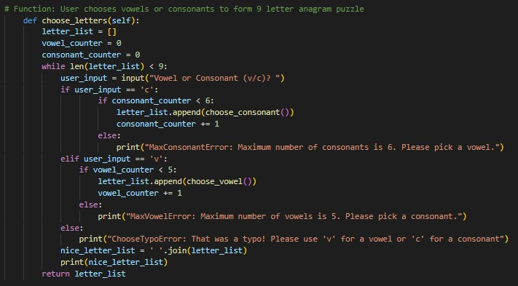
Snippet Walkthrough (How the user chooses letters!)

Slide 4
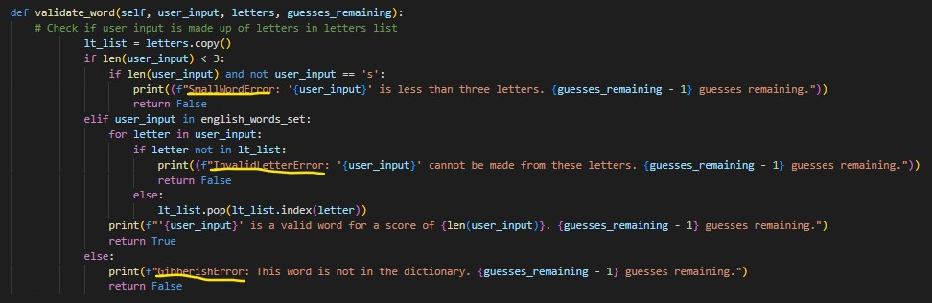
Errors

Slide 5
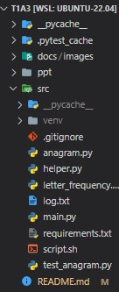
File Structure
The File Structure is that of the assignment’s deliverables criteria.
The paths to the markdown file are relative.
The python files “main”, “anagram”, “helper”, “letter_frequency” and “test_anagram” are all in the src doc.
The ‘log.txt’ file is the git log until the final commit
The ‘help.md’ file is the installation instructions from the repo.
The ‘script.sh’ file is the bash script to install the dependencies required. These are formally listed in the ‘requirements.txt’ file.

Slide 6
Review:
Challenges | Ethical Issues | Favourite Parts
Errors could be handled better, but happy it is functional. Finding an appropriate data set for English words was a compromise. Testing (as a result of bad error handling) was more difficult and more ineffective. Believing that I could actually do it was as much of a battle as the algorithms. | Uncertainty about importing packages and the copyrights to them. I had to make sure but my understanding is that they are largely open-source and free for use. The fundamental idea of the game could be interpreted as a copy/derivative for other word games. It would be interesting to unpack the validity of this assertion to see what is okay. | I really enjoyed making the difficulty algorithm. I would like to see how more complicated games write elevated difficulties. The constraints of the terminal/no GUI made the problem solving more math based. I got a thrill out of solving the issues on my own.

Slide 7

Questions?

